Slide 1






MySQL
workbench
Presented by: v merlin vensiya

Slide 2

Overview
Introduction
basic query
Characters
schema
importing
implementation
Conclusions

Slide 3




Introduction
SQL
SQL (Structured Query Language) is a programming language designed for managing data in a relational database.
What's a database?
A database is an organized collection of data.
There are many ways to organize a database and many different types of databases designed for different purposes.

Slide 4






SQL Functions (Aggregate and Scalar Functions)
SQL Functions are built-in programs that are used to perform different operations on the database.
There are two types of functions in SQL:
Aggregate Functions
Scalar Functions
SQL Aggregate Functions
SQL Aggregate Functions operate on a data group and return a singular output. They are mostly used with the GROUP BY clause to summarize data.

Slide 5
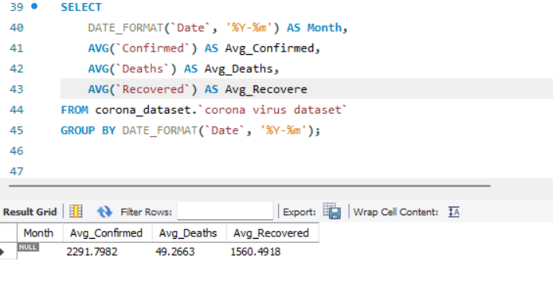
Avg()
Calculates the average value
SELECT AVG(column_name) FROM table_name;

Slide 6
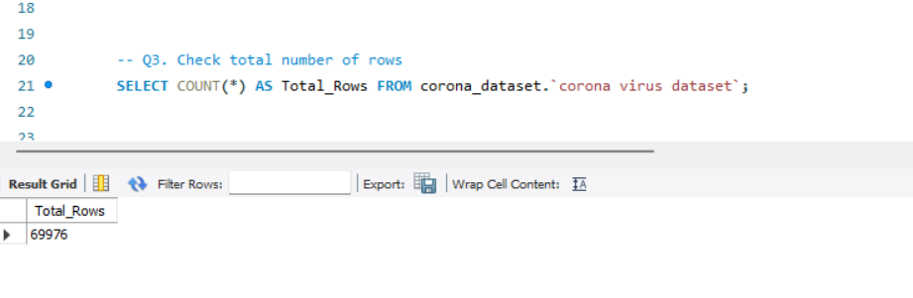
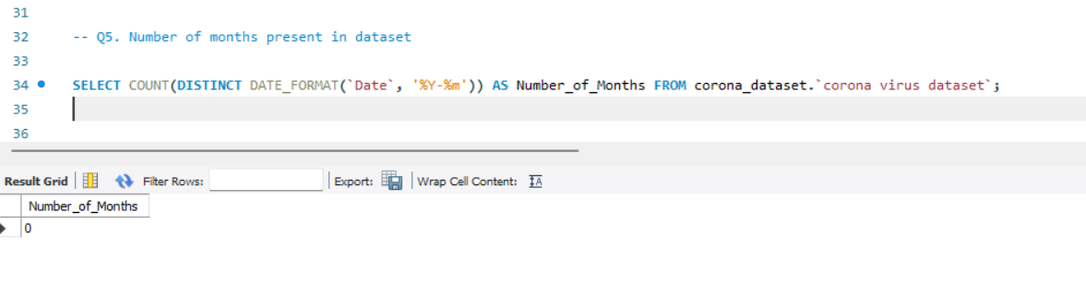
COUNT()
Counts the number of rows
SELECT COUNT(column_name) FROM table_name

Slide 7
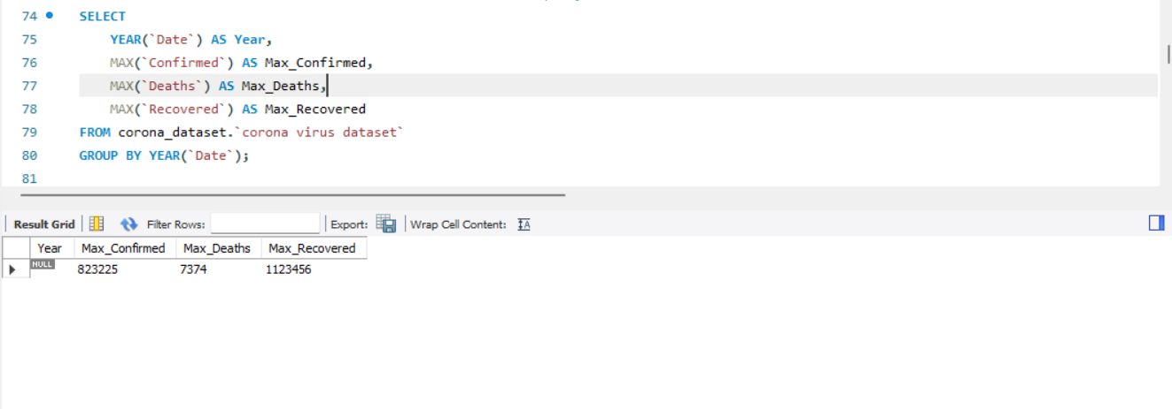
MAX()
Retrieves the maximum value from a column
SELECT MAX(column_name) FROM table_name;

Slide 8
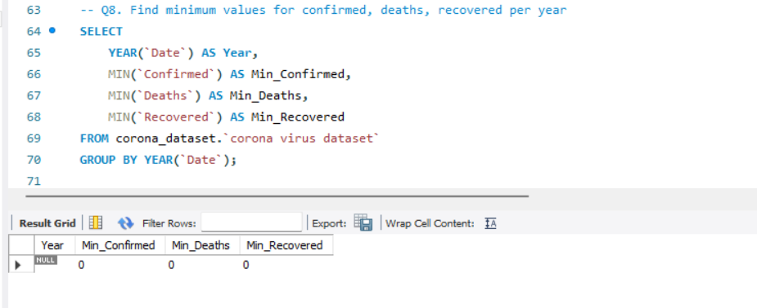
MIN()
Retrieves the minimum value from a column
SELECT MIN(column_name) FROM table_name;

Slide 9
FIRST()
Returns the first value in an ordered set of values
SELECT FIRST(column_name) FROM table_name;
LAST()
Returns the last value in an ordered set of values
SELECT LAST(column_name) FROM table_name;

Slide 10
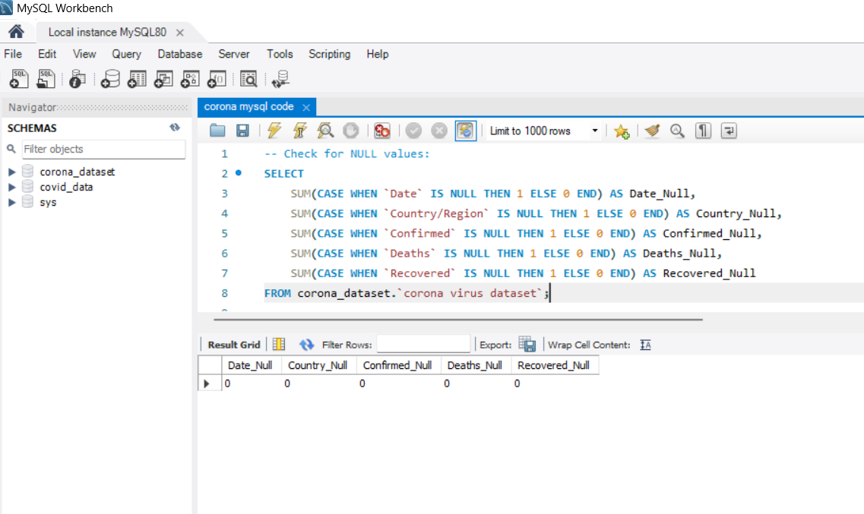
SUM()
calculates the total sum of values in a numeric column
SELECT SUM(column_name) FROM table_name;

Slide 11
Important Points About SQL Functions
SQL functions are built-in programs that are used to manipulate data in various ways.
There are different types of SQL functions – Aggregate functions and Scalar functions.
Aggregate functions perform calculations on a group of values and return a single value. Example SUM, AVG, COUNT.
Scalar functions operate on a single value and return a single value. Example UPPER, LOWER, SUBSTRING.
SQL functions can be used in different SQL statements, such as SELECT, WHERE, GROUP BY, and ORDER BY, to improve data processing and analysis.

